Slide 1
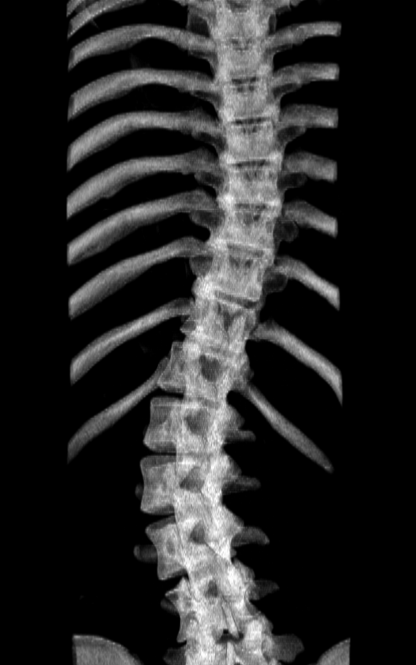

Slide 2
Automatic landmark generation (Ch. 4)
Tracked ultrasound scan (2.3)
Bone segmentation (4.1)
Landmark generation (4.2)
Landmark set repair (4.3)
Scoliosis visualization (Ch. 3)
Healthy-shaped surface and landmarks (3.3)
Thin-plate spline registration (3.4)
Transverse process locations (3.2)
Patient-specific 3D surface visualization (3.5)

Slide 3
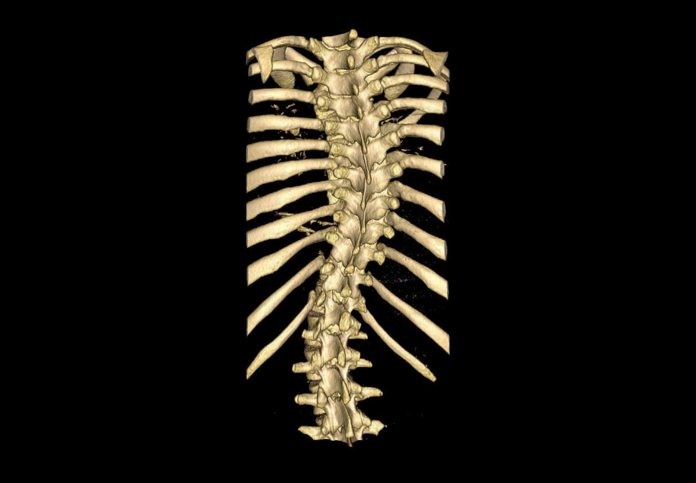
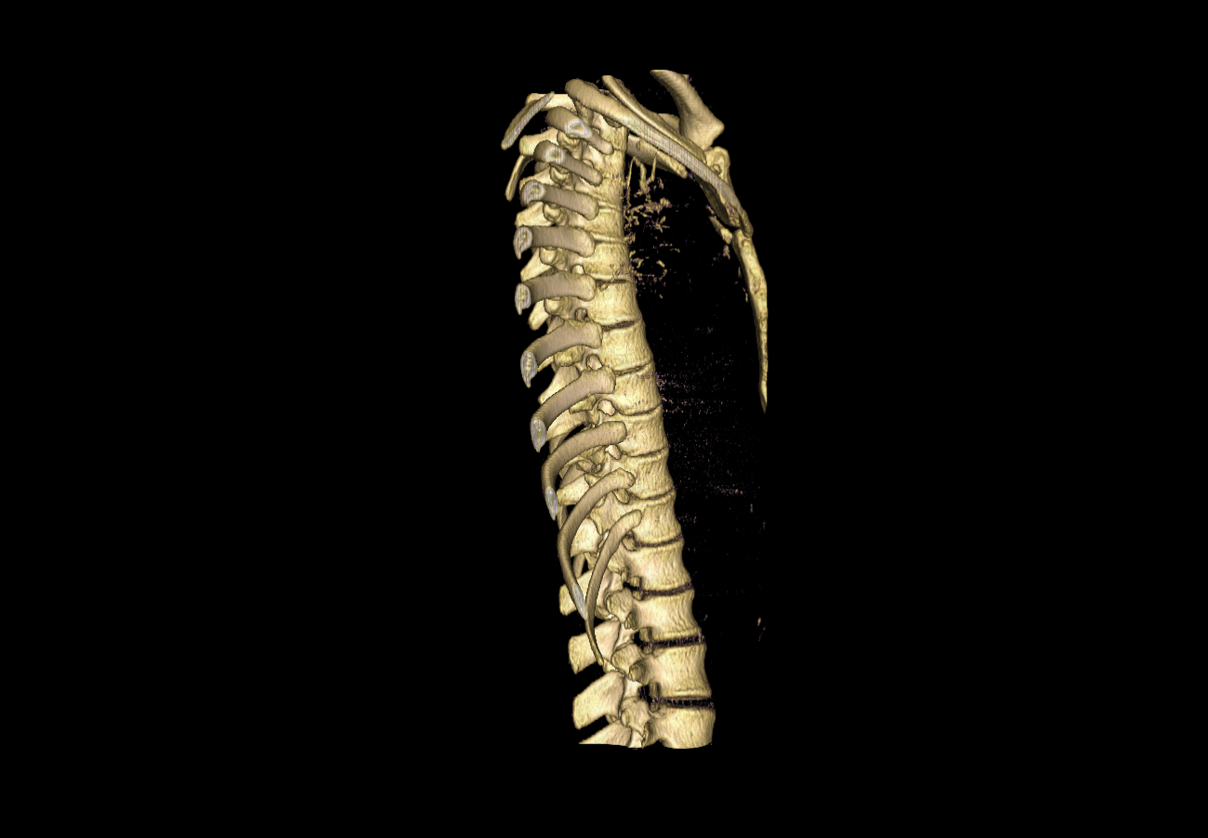

Slide 4
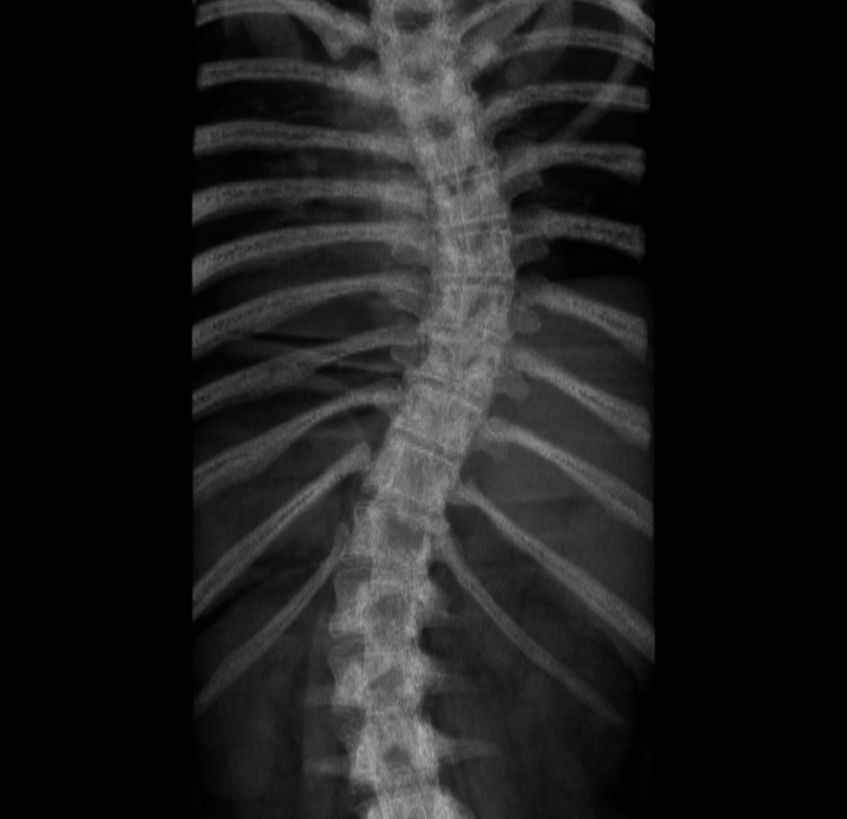
Cobb Angle
Apical Vertebra
End Vertebrae
Secondary Curvature

Slide 5
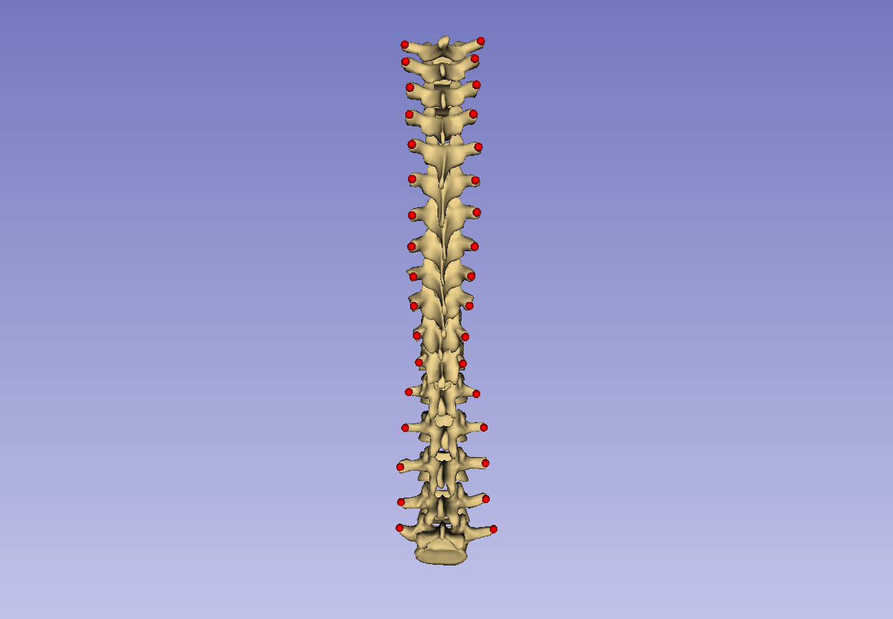
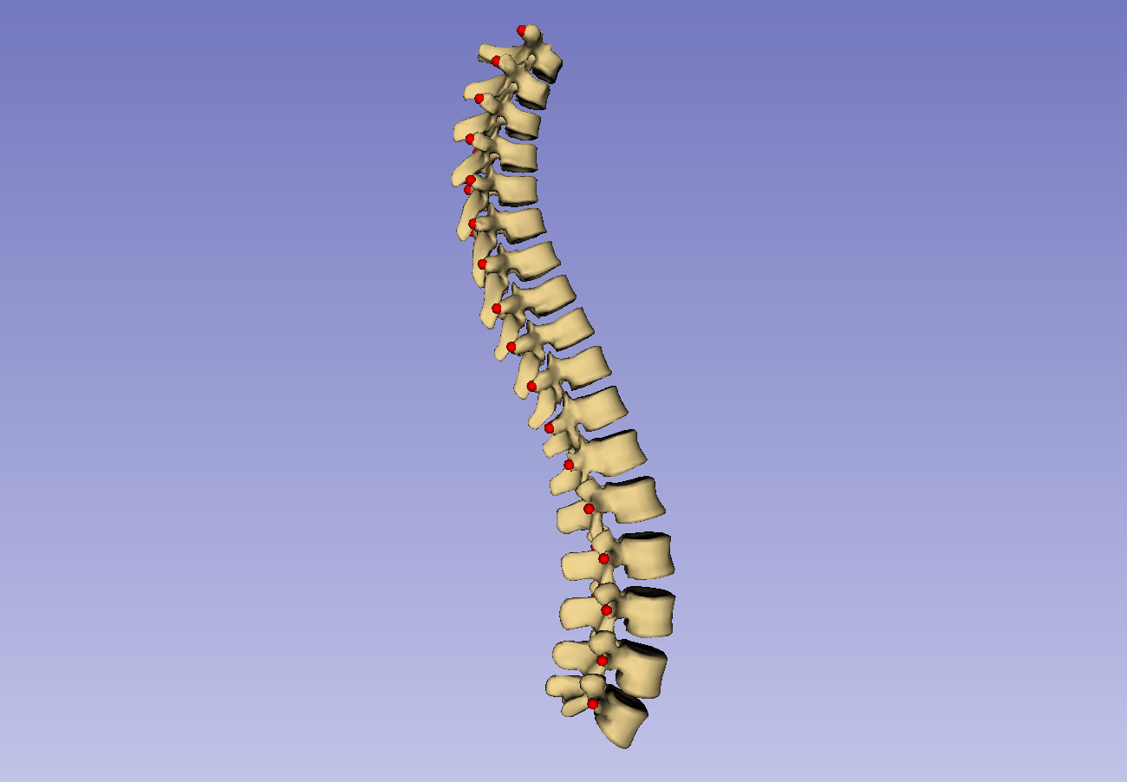

Slide 6
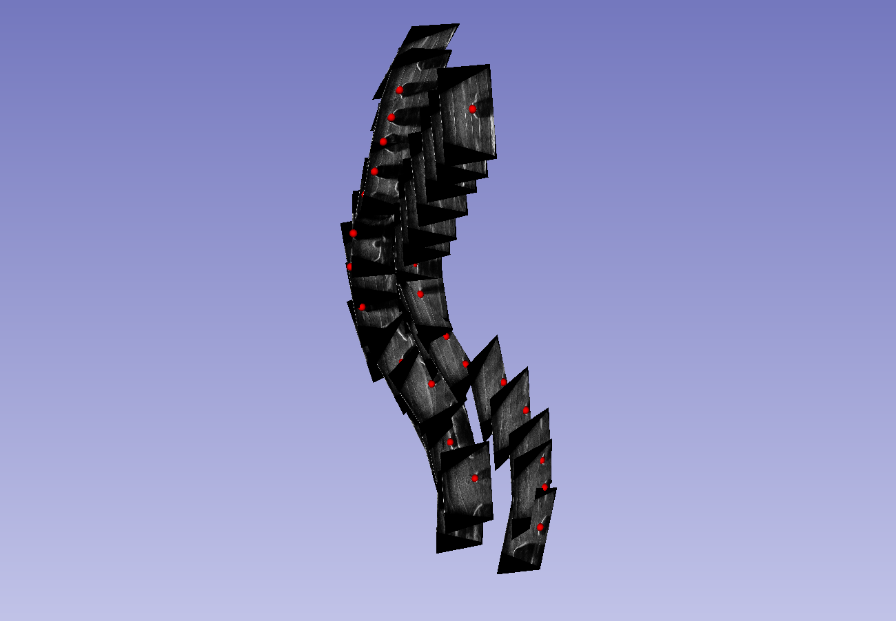
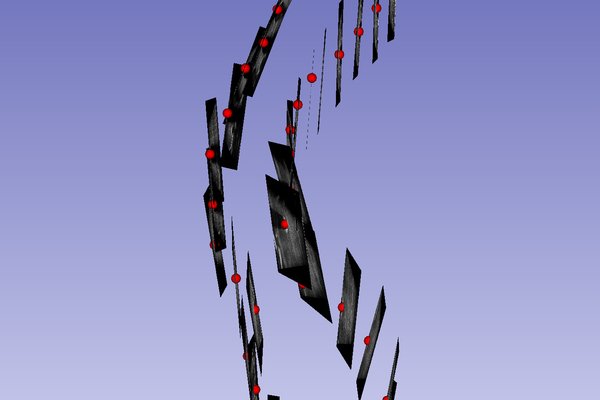
Coronal tilt

Slide 7
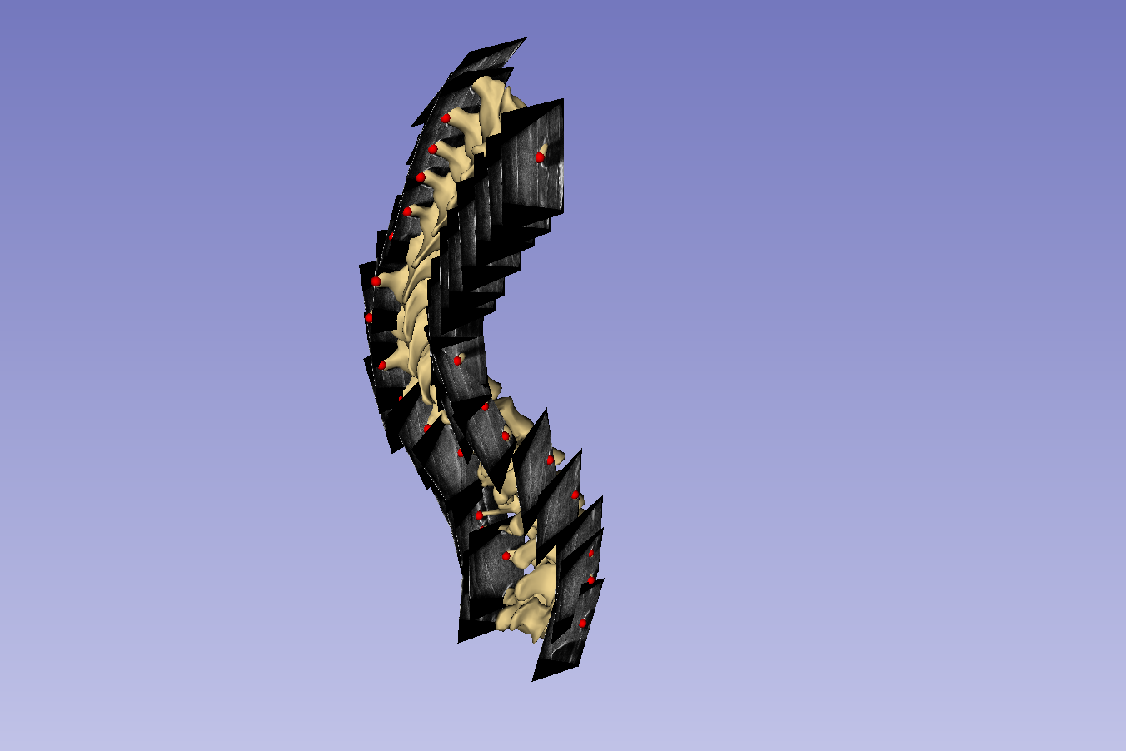
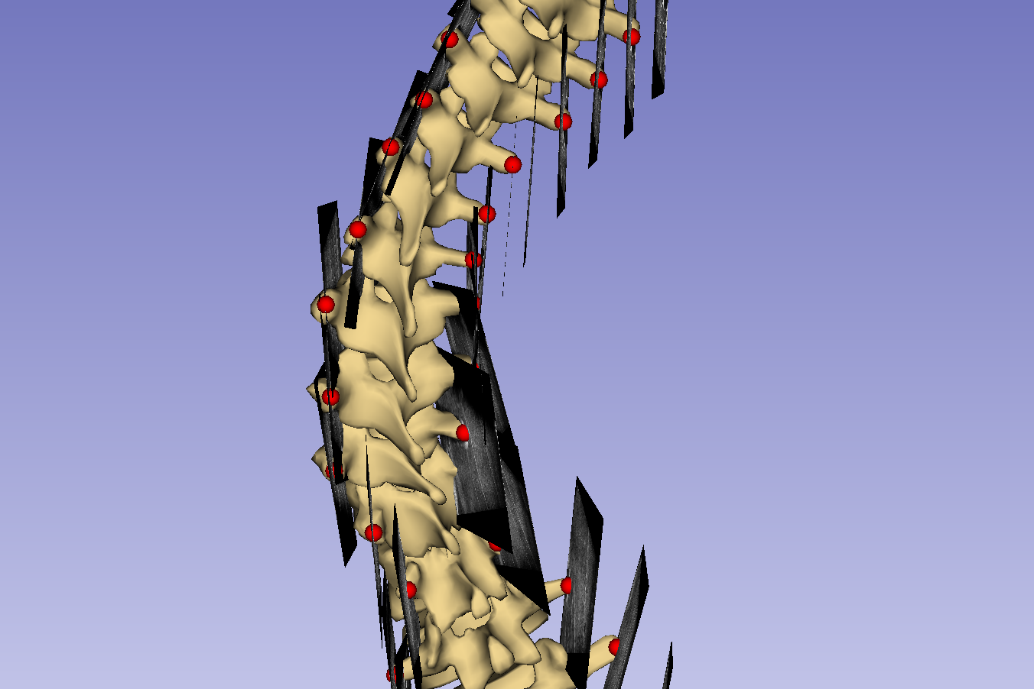
Coronal tilt

Slide 8
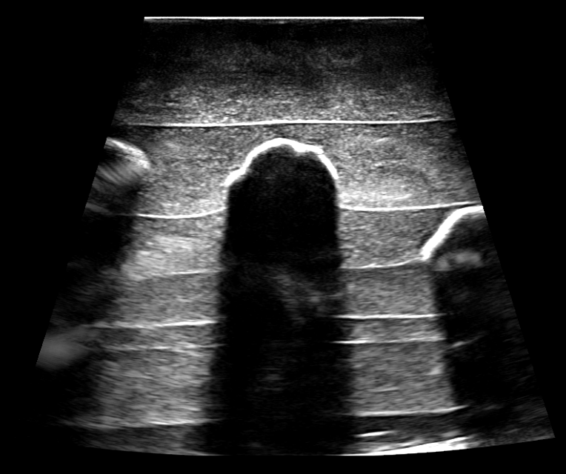

Slide 9
a
b

Slide 10
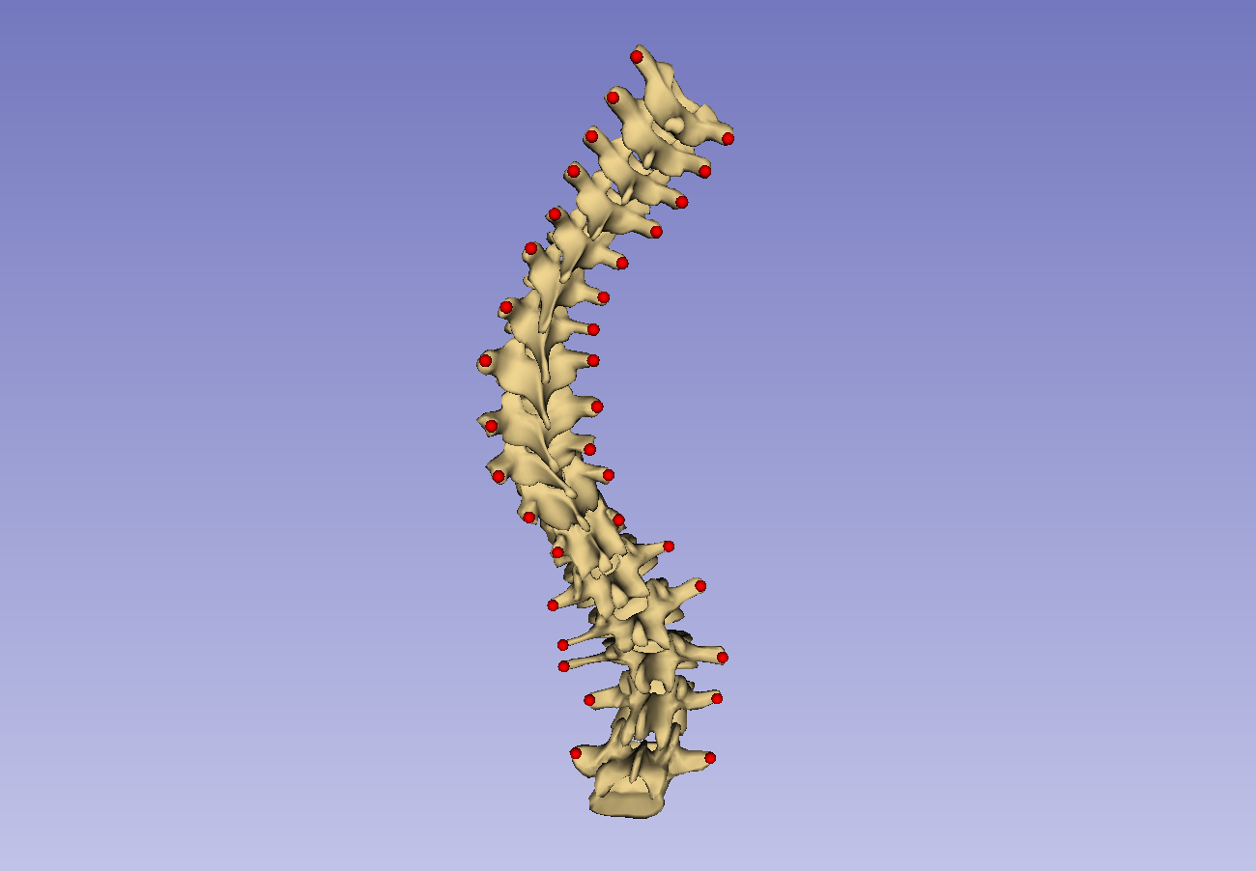
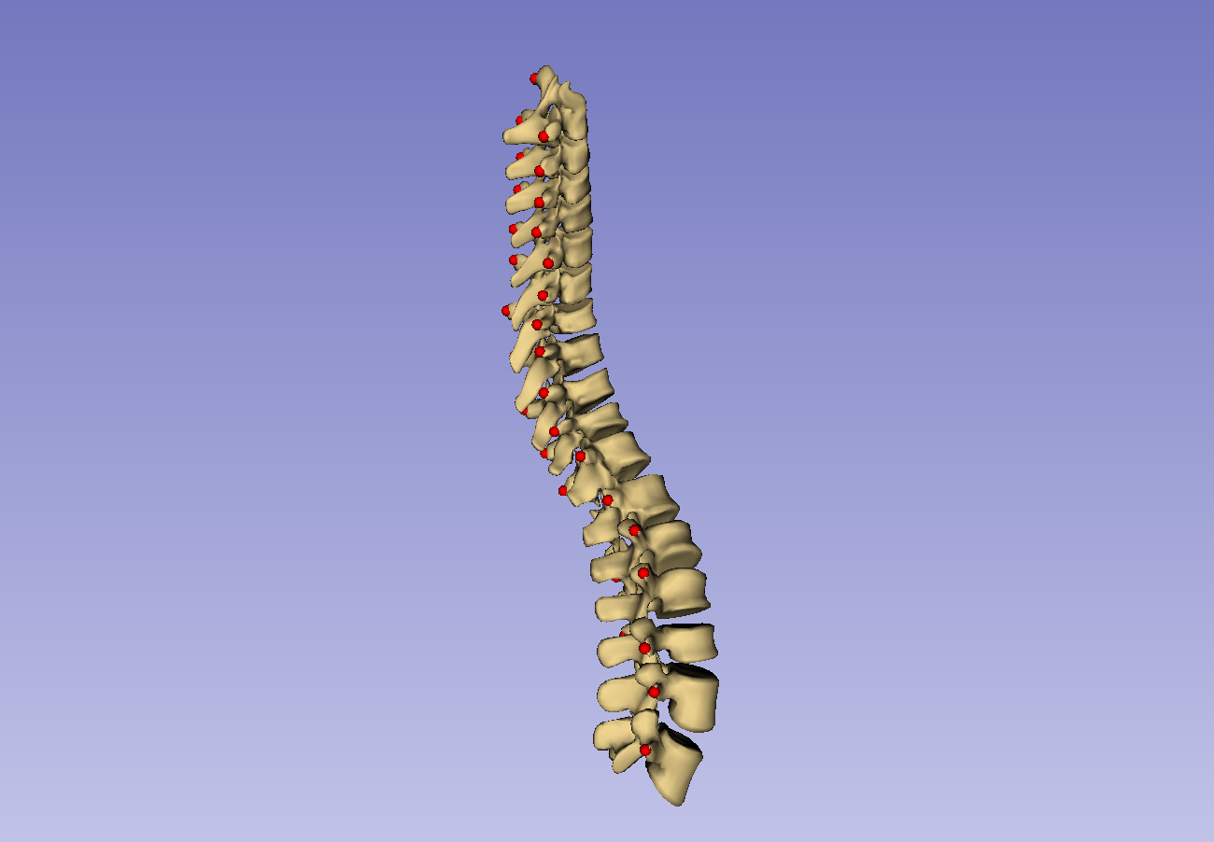

Slide 11
Patient transverse process locations
Anchor point supplementation
Healthy-shaped model: points
Thin-plate spline registration
Healthy-shaped model: surface
Patient registration points
Thin-plate spline transform
Warping transform
Patient-specific visualization

Slide 12
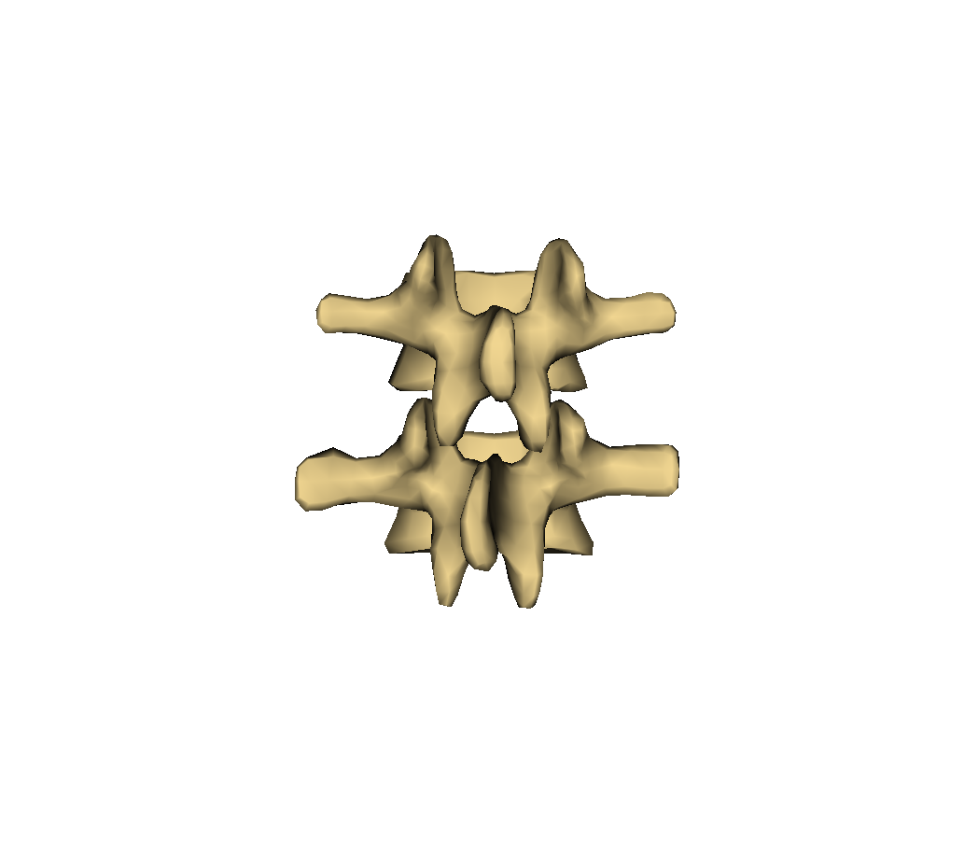
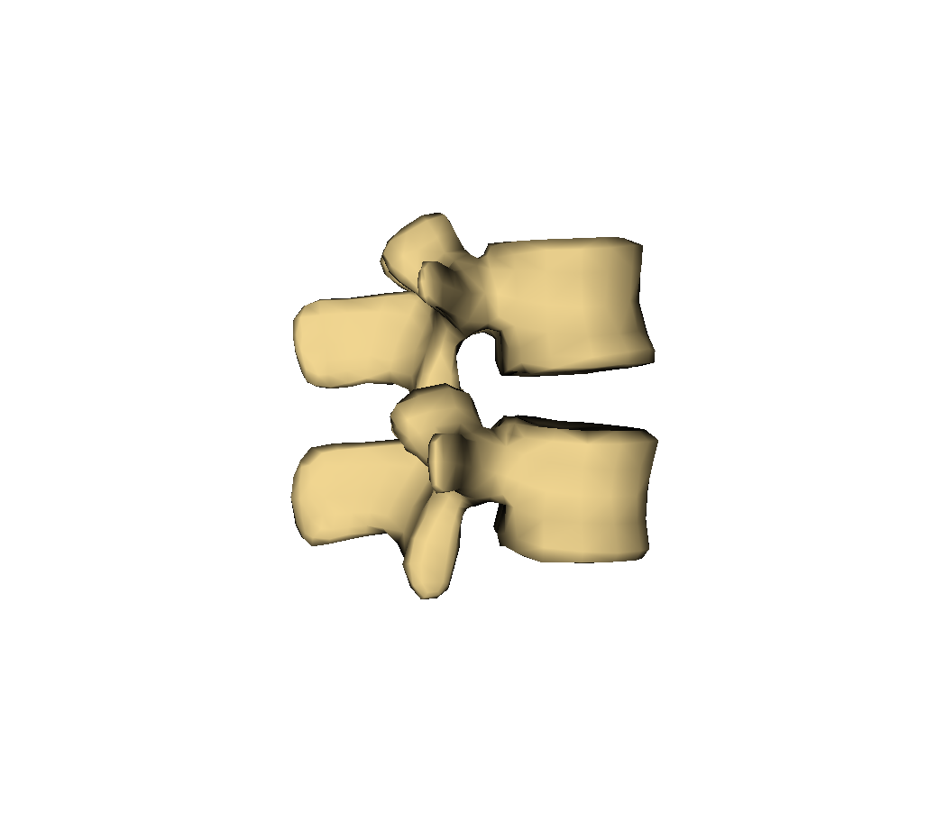
Vertebral body
Transverse process
Superior articular process
Facet joint
Spinous process
Inferior articular process
Lamina

Slide 13
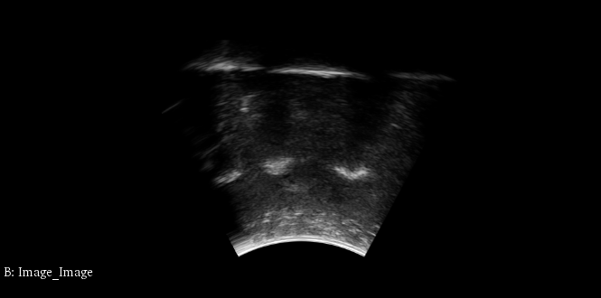
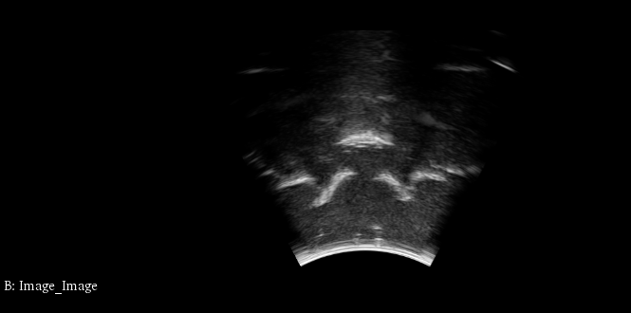
Lam
TP
AP
TP
VB
Legend: TP – Transverse process; VB – Vertebral body; Lam – Lamina; AP – Articular process

Slide 14
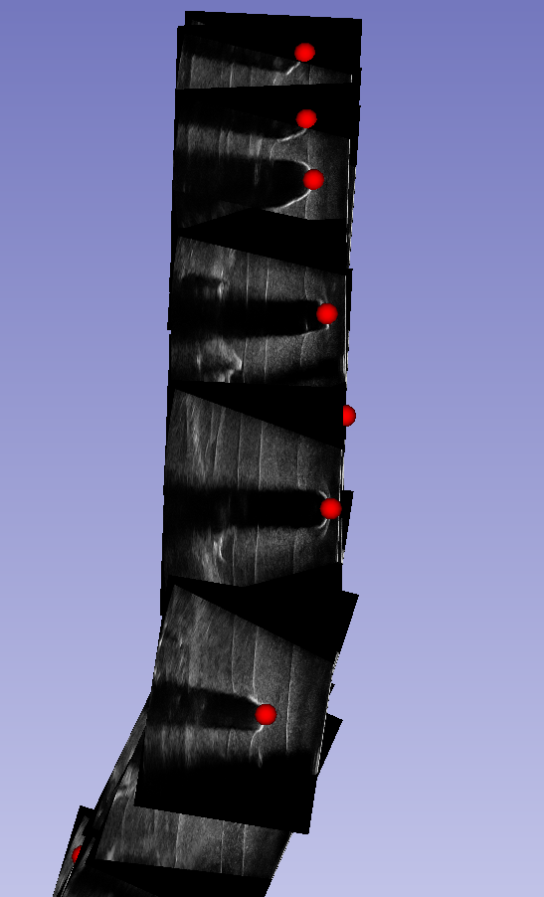

Slide 15
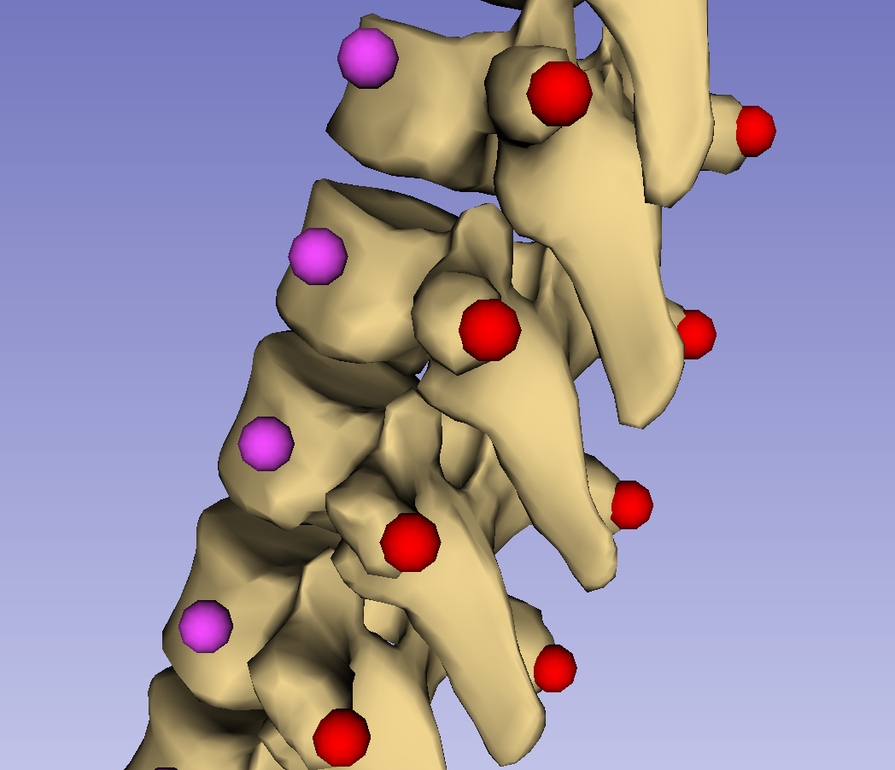
P*(7,0)
<SI(8,0)>
P(7,0)
P(7,1)
<RL(8,0)>
P*(8,0)
<AP(8,0)>
P(8,0)
P(8,1)
P*(9,0)
P(9,1)
P(9,0)

Slide 16
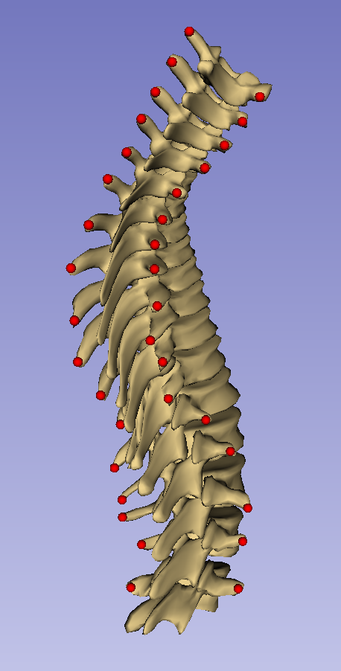
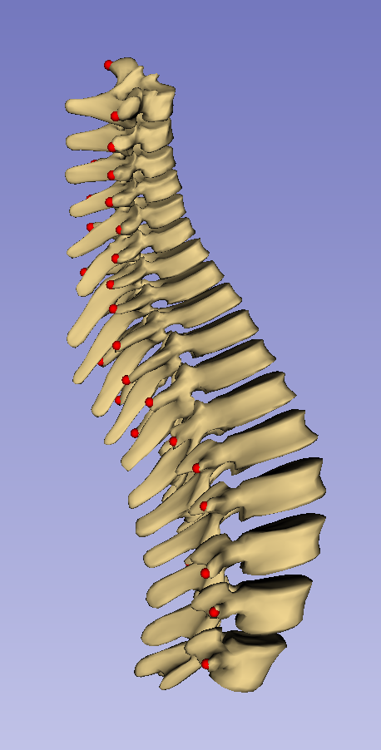

Slide 17
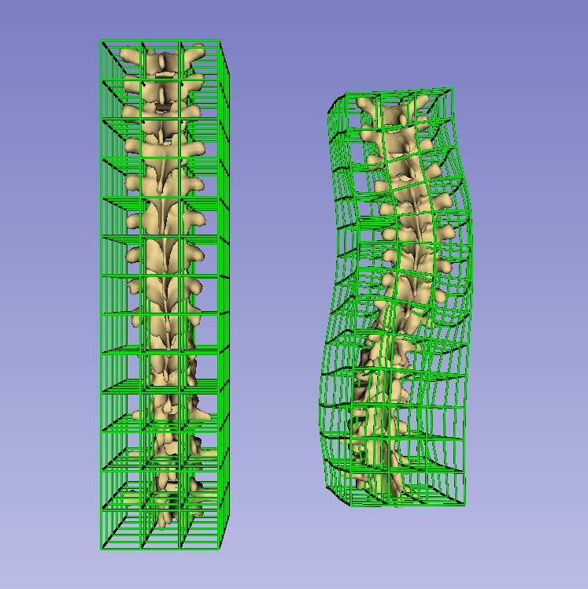

Slide 18
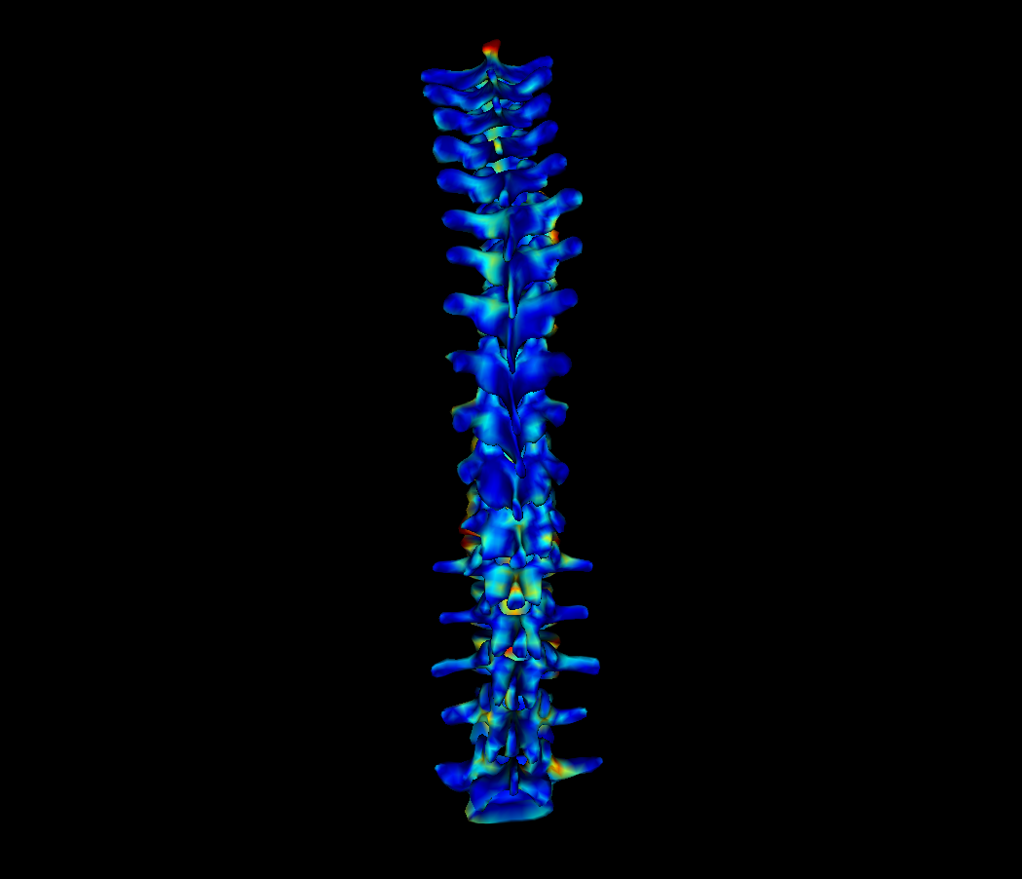
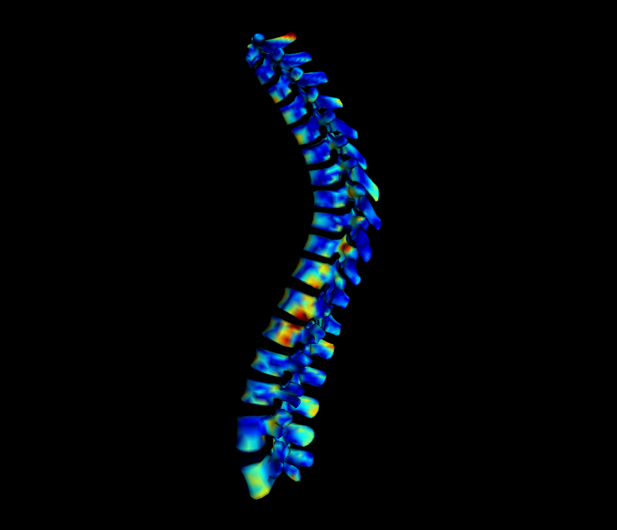
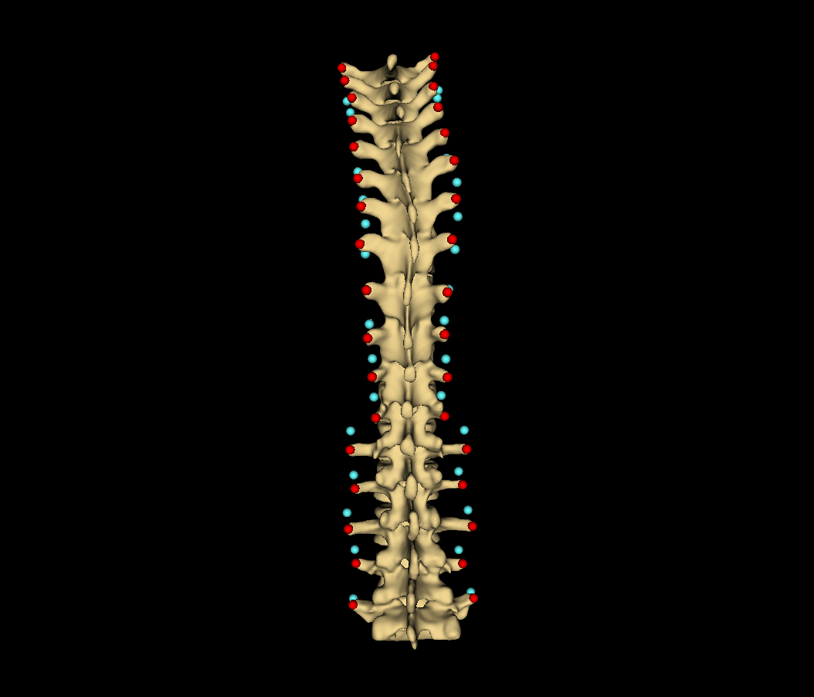
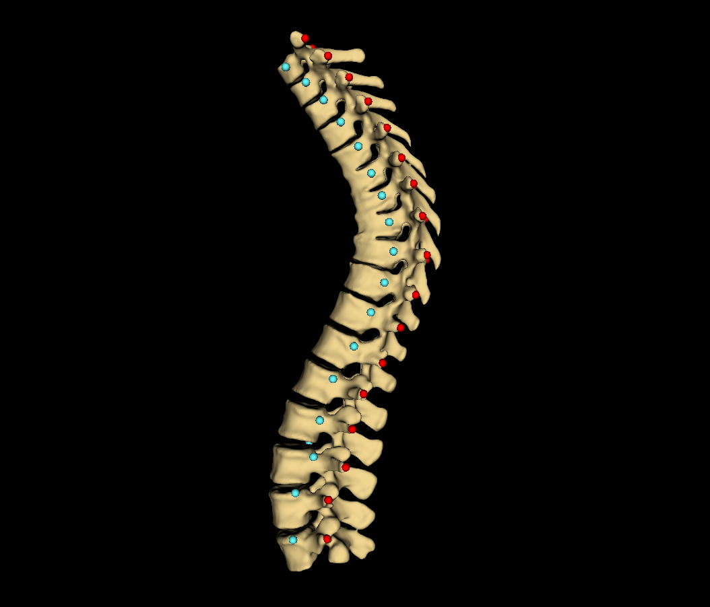

Slide 19
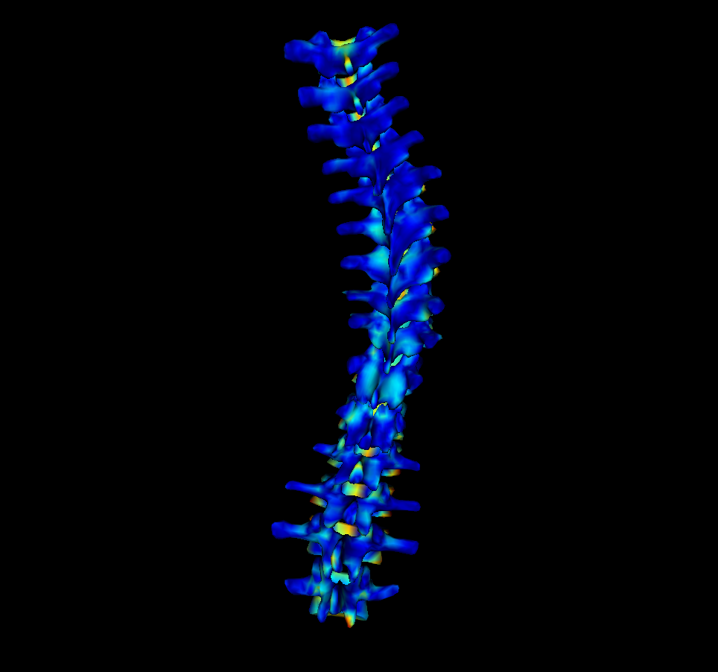
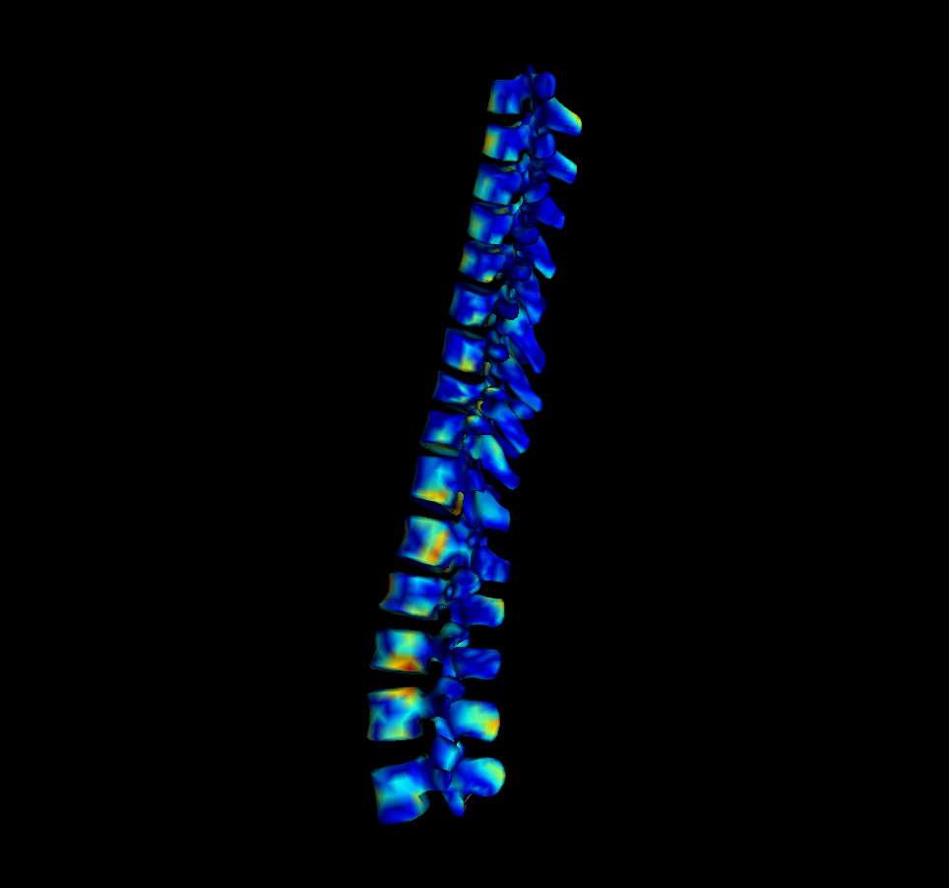
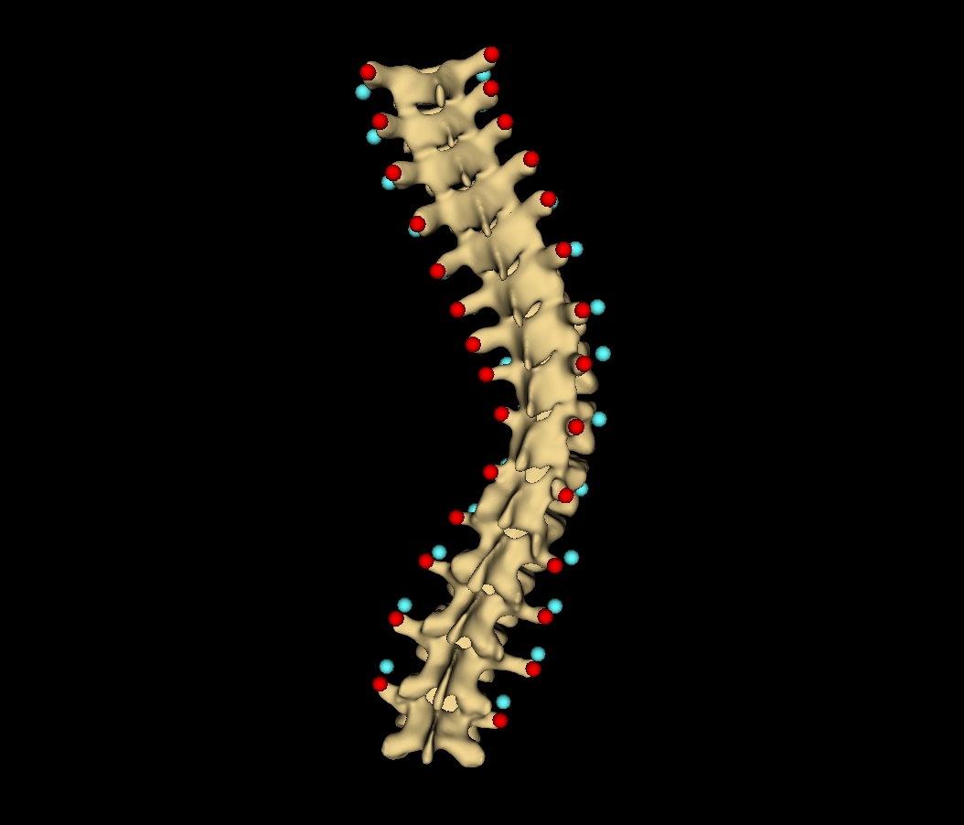
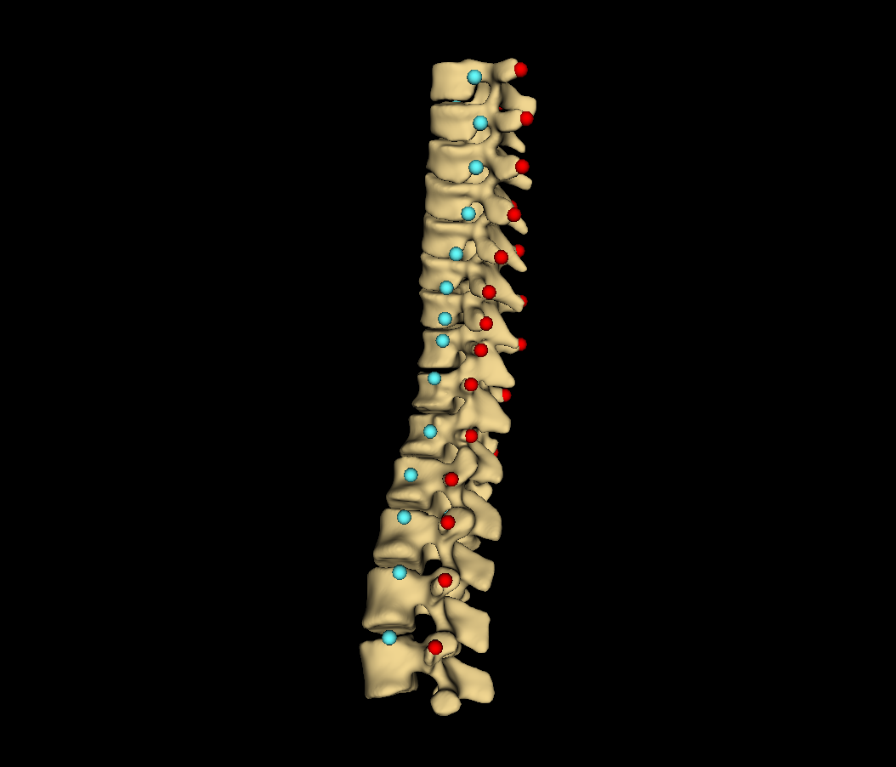

Slide 20
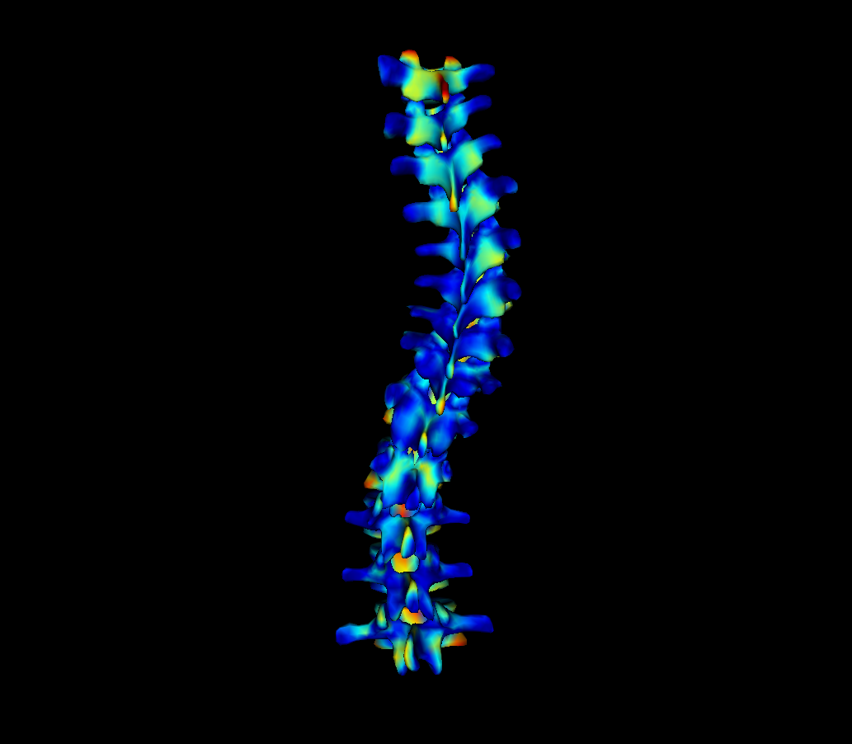
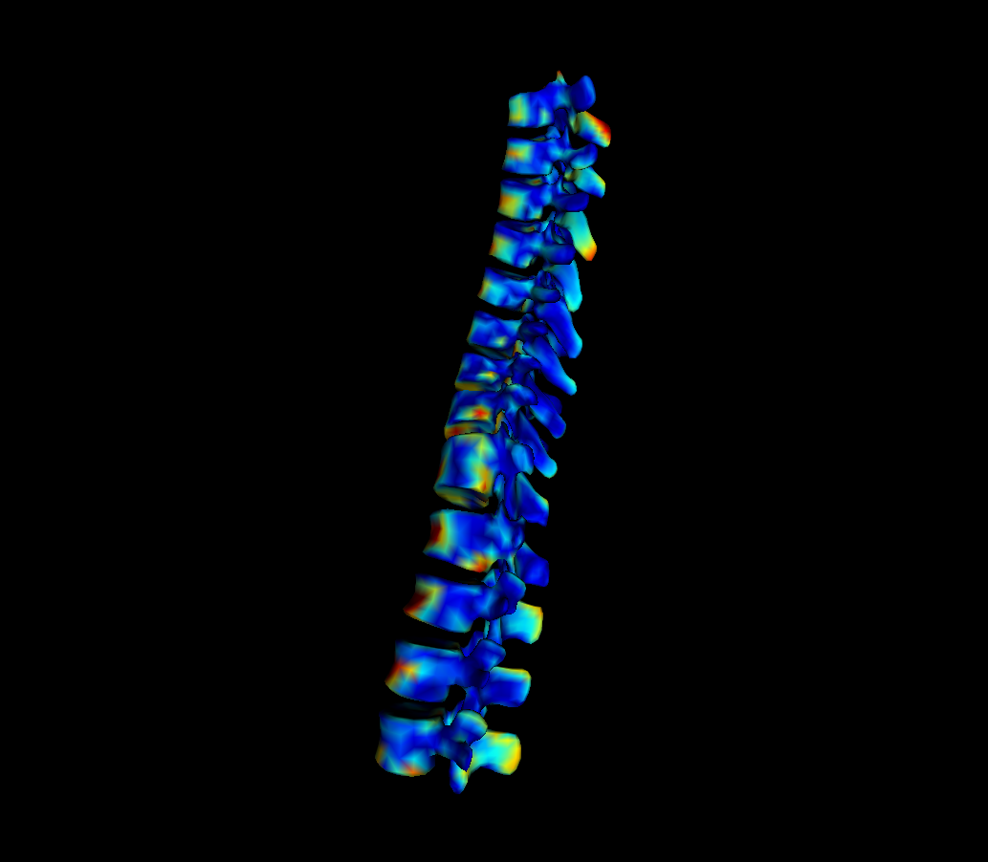
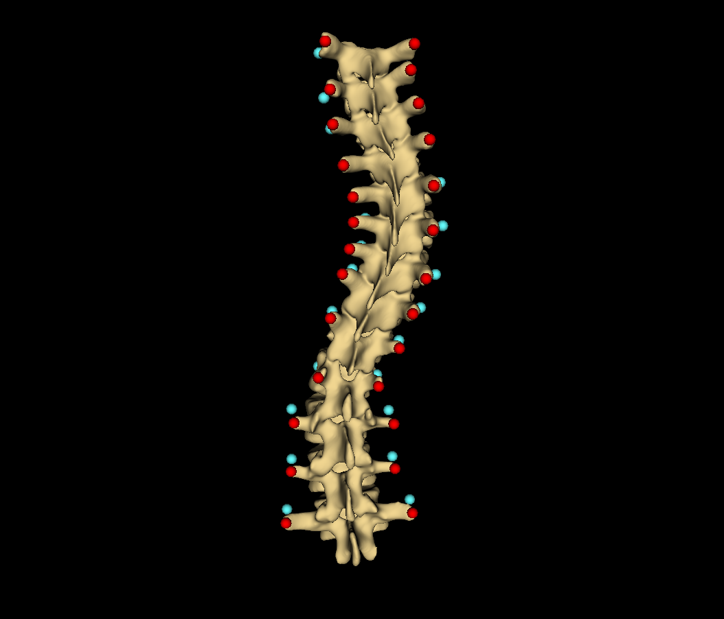
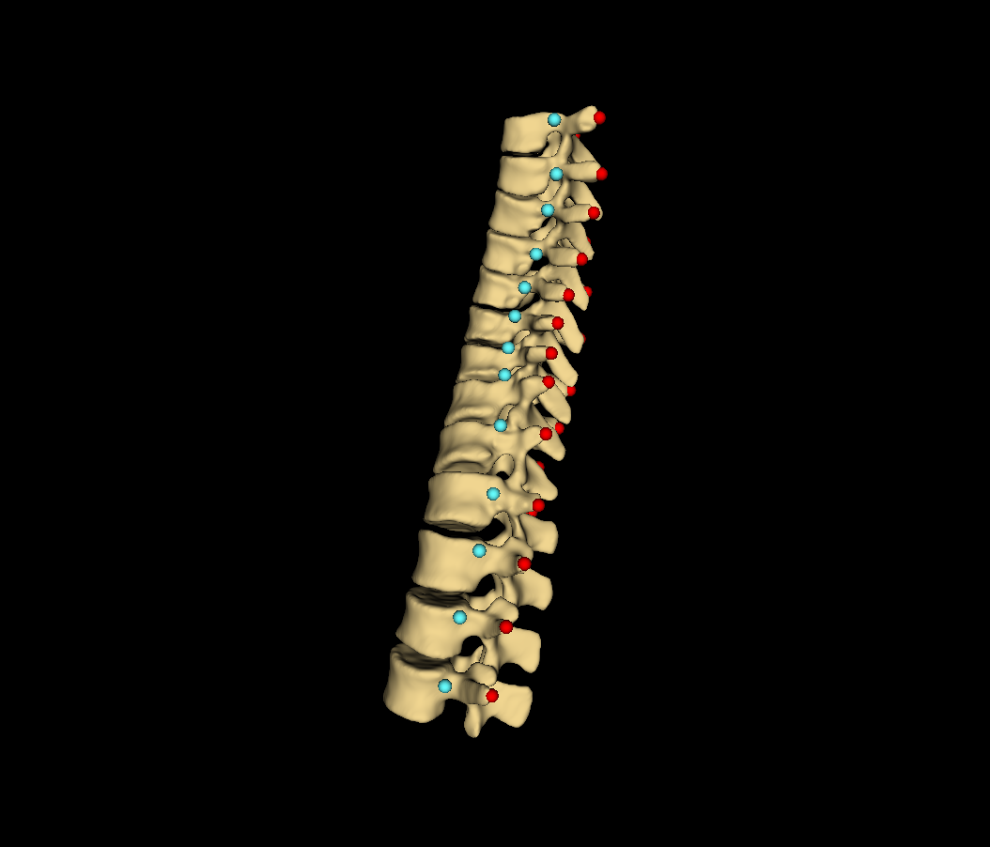

Slide 21
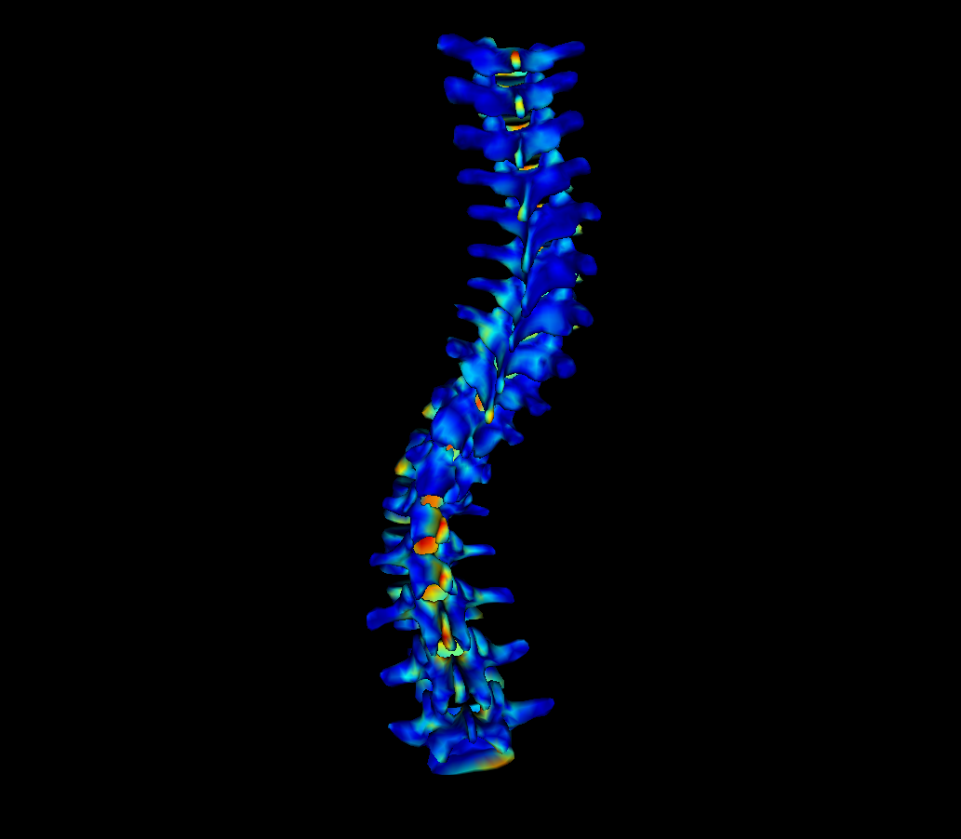
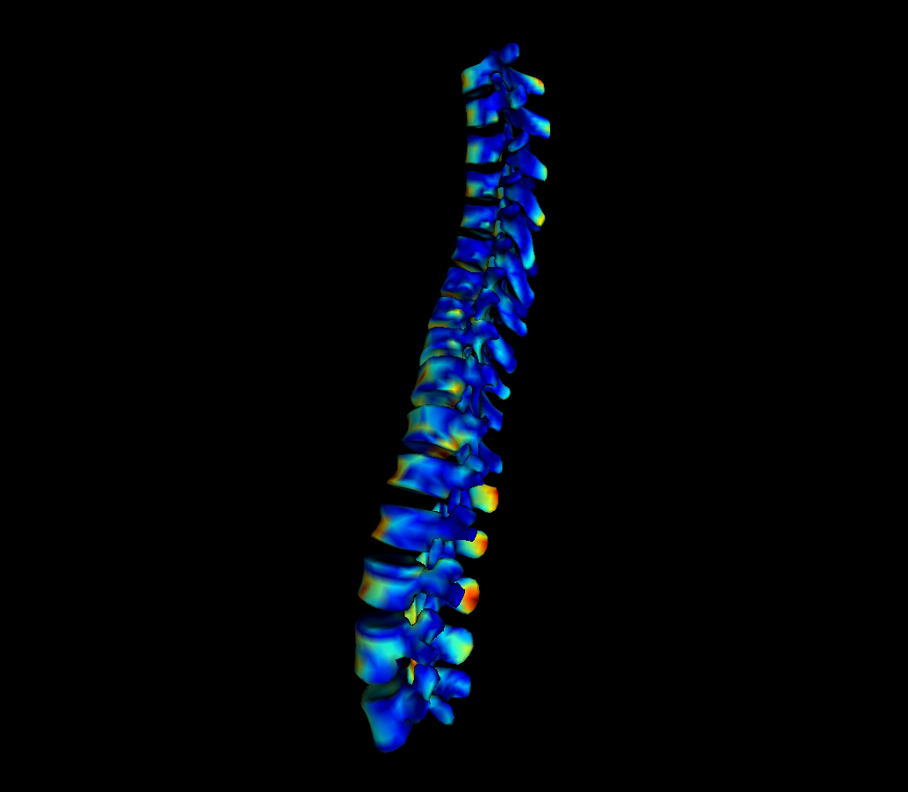
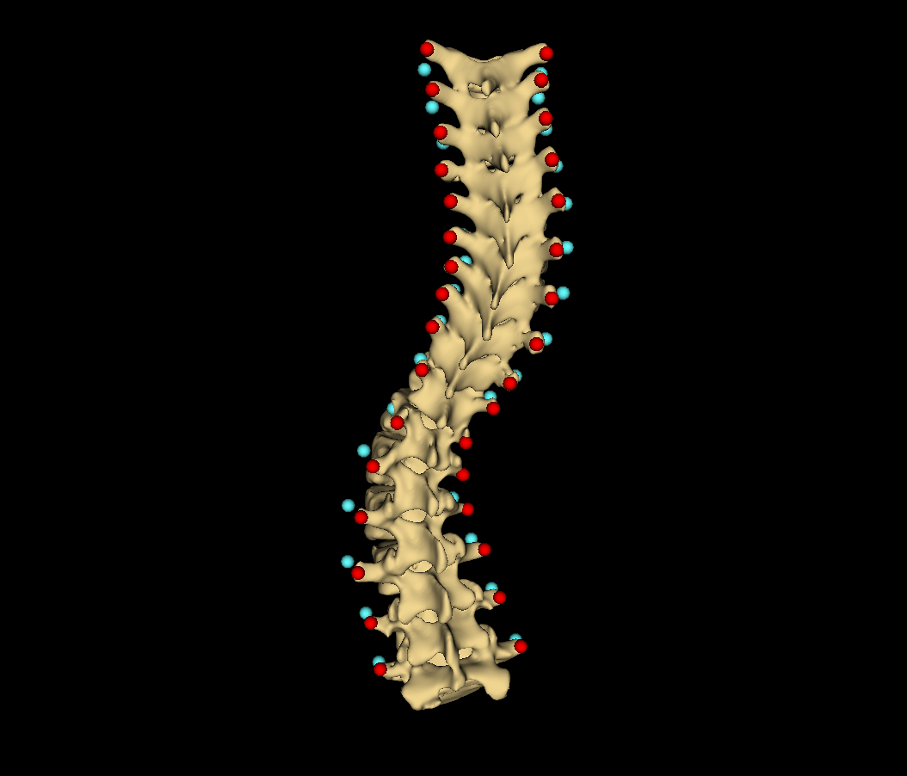
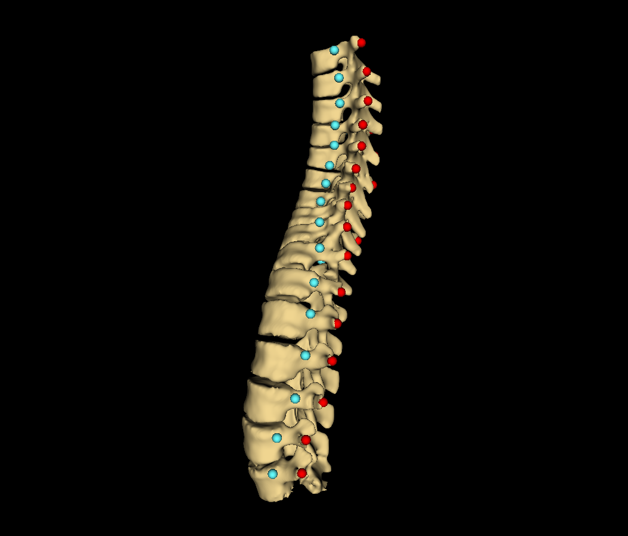

Slide 22
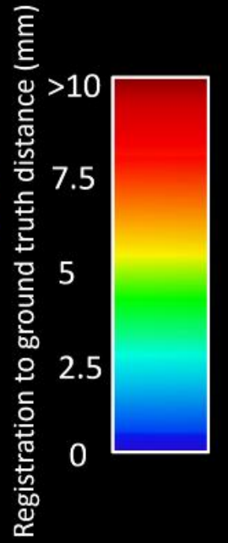
Distance map
Ground truth
Patient #
Registration to ground-truth distance (mm)
>10
2
7.5
3
5
8
2.5
13
0

Slide 23
Automatic landmark generation (Ch. 4)
Tracked ultrasound scan (2.3)
Bone segmentation (4.1)
Landmark generation (4.2)
Landmark set repair (4.3)
Scoliosis visualization (Ch. 3)
Healthy-shaped surface and landmarks (3.3)
Thin-plate spline registration (3.4)
Transverse process locations (3.2)
Patient-specific 3D surface visualization (3.5)

Slide 24
PLUS
3D Slicer
PLUS Server
Image acquisition
Image processing and segmentation
IGTLink Server
IGTLink Client
Tracked ultrasound scan
Segmentation as label map

Slide 25
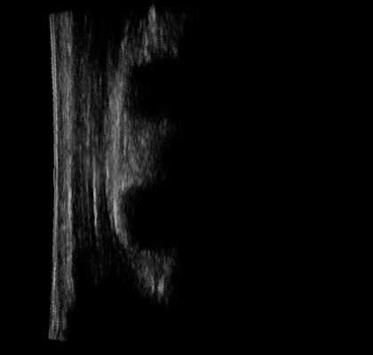





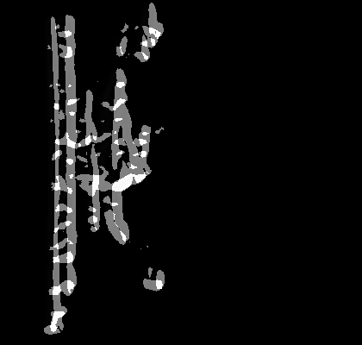

a
e
b
f
c
g
d
h

Slide 26
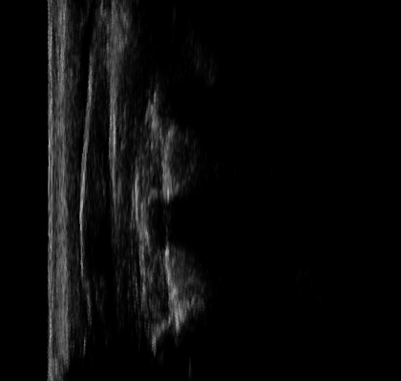

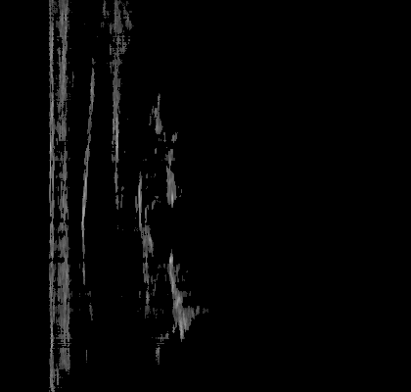



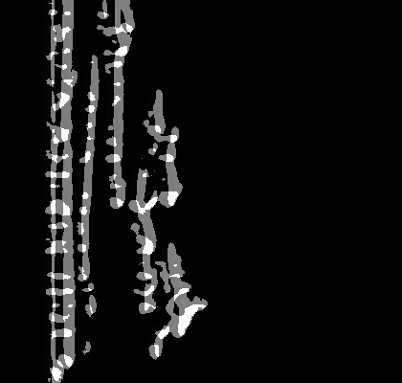

a
e
b
f
c
g
d
h

Slide 27

a
b
c

Slide 28

a
b
c

Slide 29


Slide 30


Slide 31
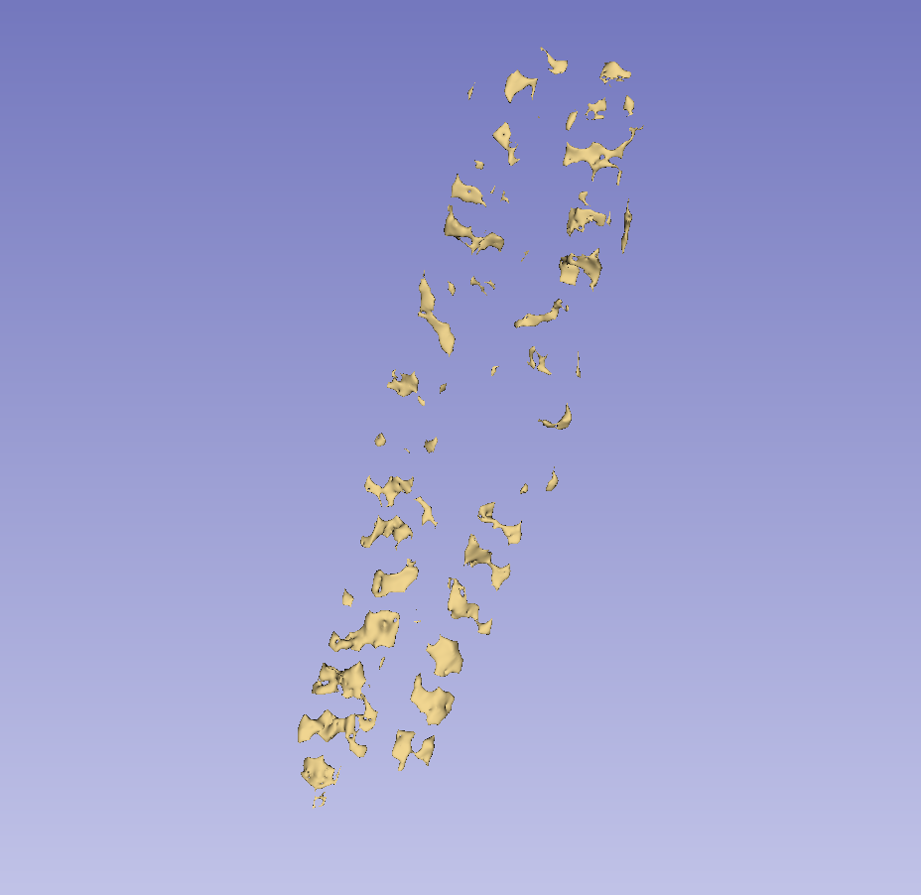
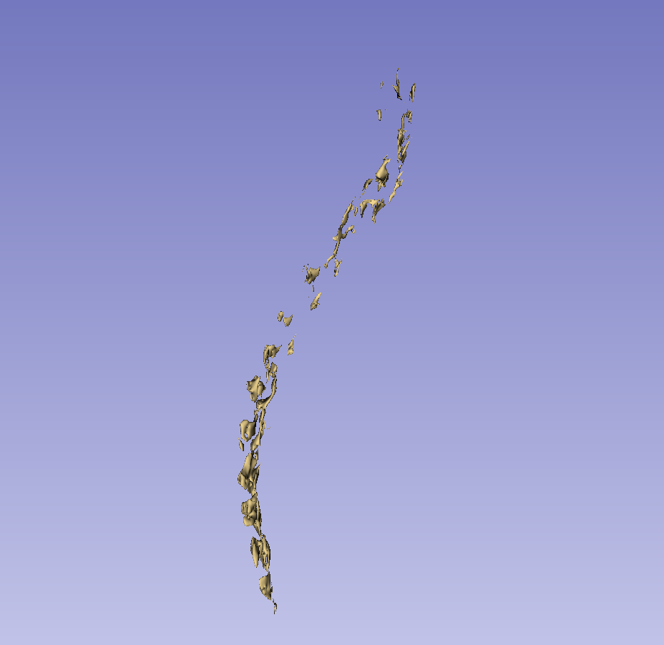

Slide 32
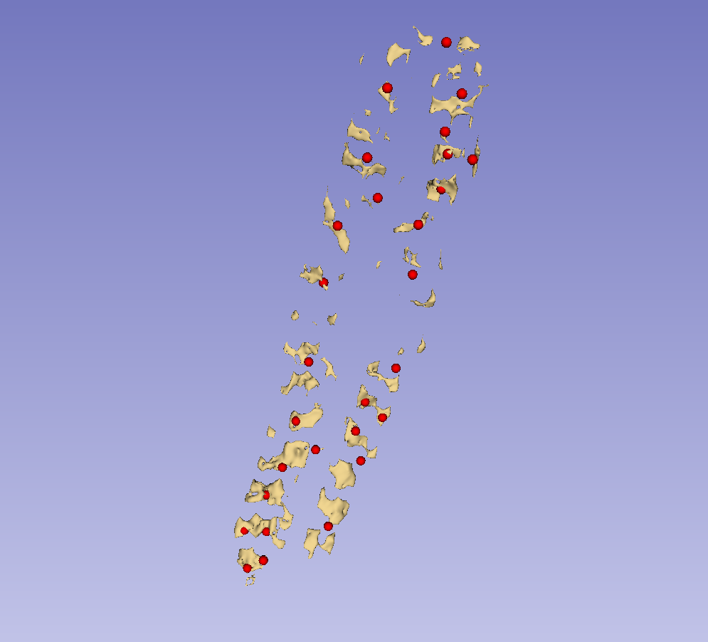

Slide 33
a
b
c

Slide 35
Reference direction
Candidate direction
Candidate direction
Reference direction
a
b
c

Slide 36
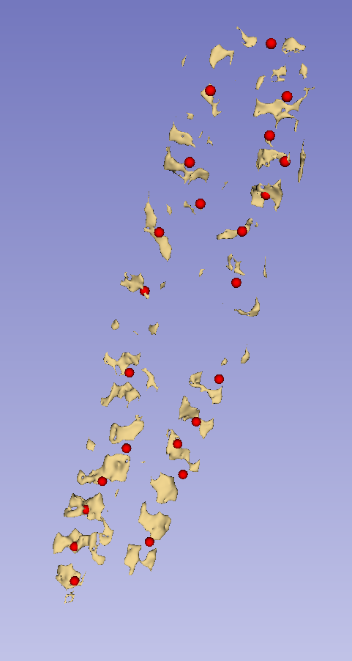

Slide 37
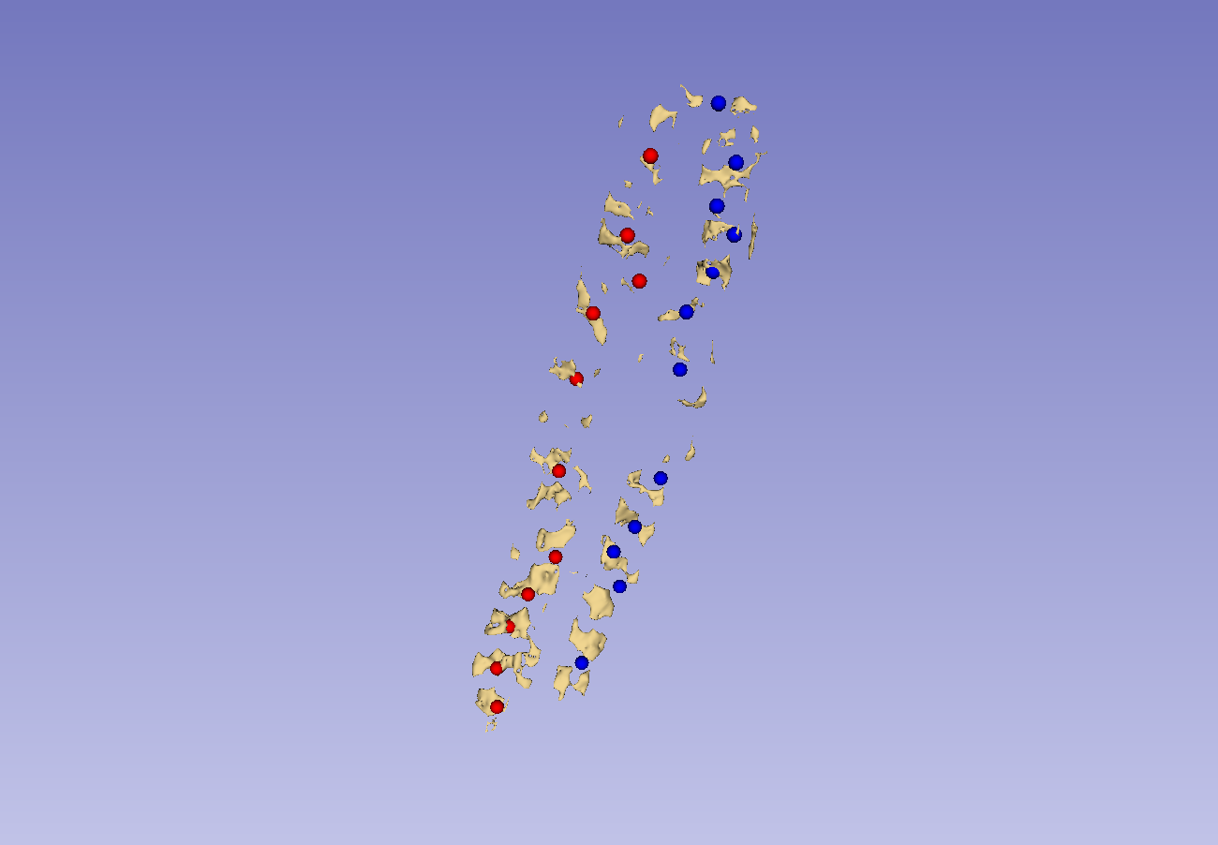
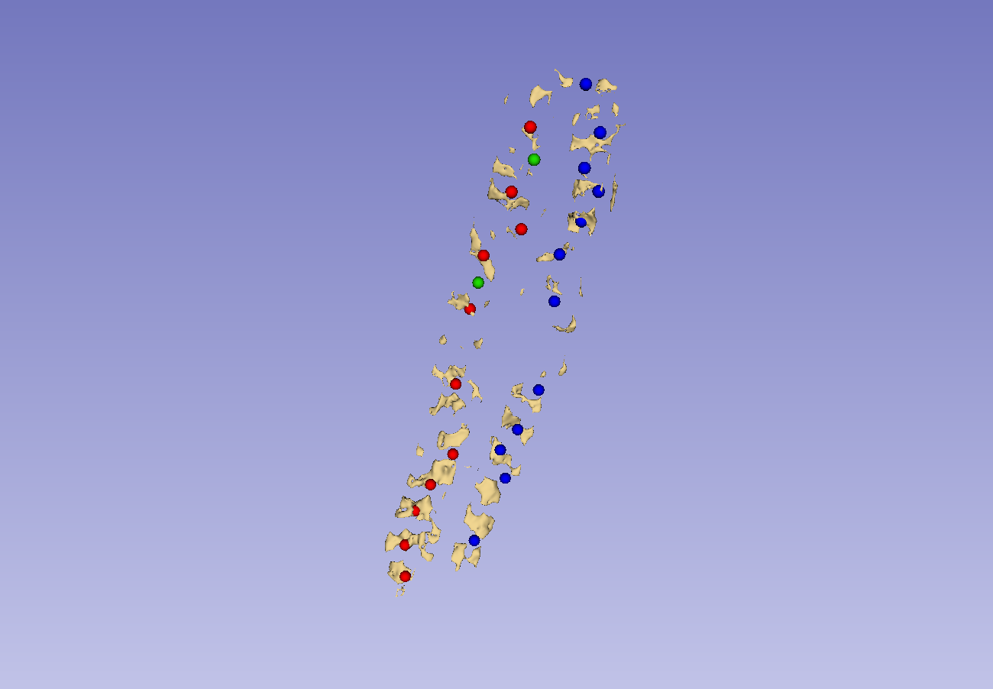






a
b
c
d
e
f
g
h

Slide 38




a
b
c
d

Slide 39




a
b
c
d

Slide 40
θ₁
V_{c1}
V_{ref}
θ₂
θ₁
V_{c1}
V_{c2}
V_{ref}
V_{c2}
θ₂
a
b
c

Slide 41



a
b
c

Slide 42



a
b
c

Slide 43


Slide 44


a
b
c

Slide 45



Slide 46

Tracked US probe
Field generator for tracking
Monitor
Reference position sensor
US machine

Slide 47

























1
2
3
4
5
a
b
c
d
e

Slide 48










1
2
3
4
5

Slide 49
Automatic landmark generation (Ch. 4)
Tracked ultrasound scan (2.3)
Bone segmentation (4.1)
Landmark generation (4.2)
Landmark set repair (4.3)
Scoliosis visualization (Ch. 3)
Healthy-shaped surface and landmarks (3.3)
Thin-plate spline registration (3.4)
Transverse process locations (3.2)
Patient-specific 3D surface visualization (3.5)

